Slide 1


Chinook Music Album
Database
Online Music Store
MYSQL

Slide 2

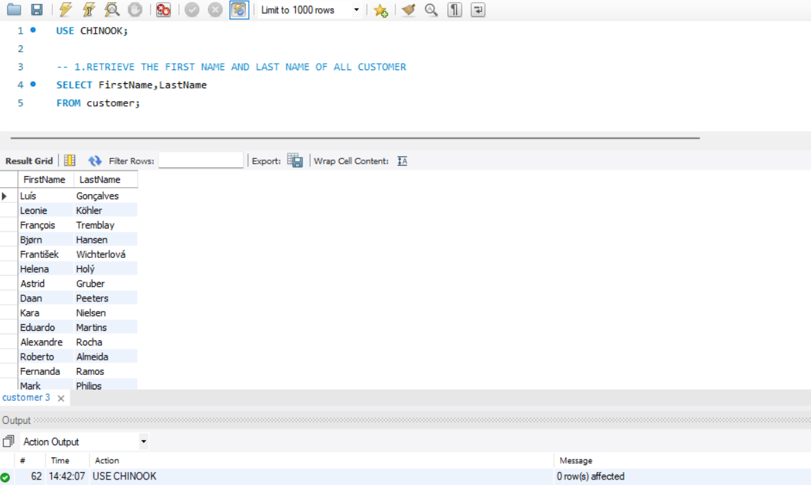
BASIC SELECT STATEMENT
Retrieves the FIRSTNAME and LASTNAME of every record from the CUSTOMER table

Slide 3
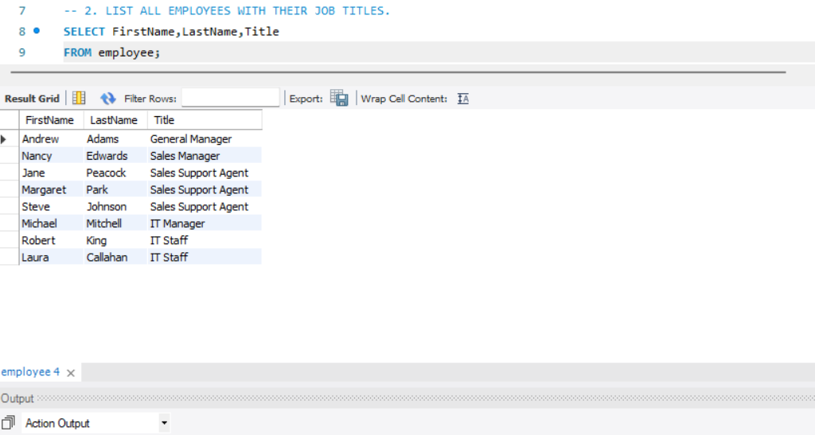
BASIC DATA RETRIEVAL IN SQL
This query extracts specific columns-FirstName, LastName, and Title-from the EMPLOYEE table to display selected employee details

Slide 4
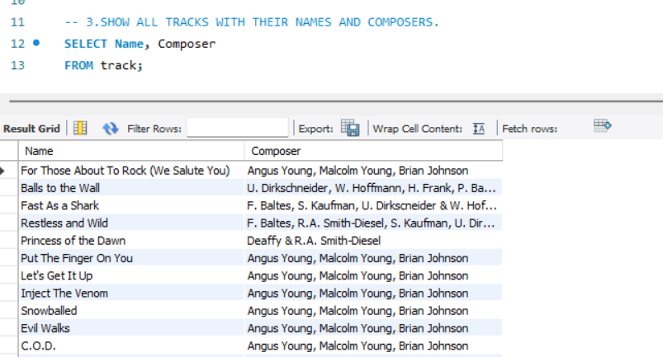
COLUMN SELECTION IN SQL
This query retrieves only the NAME and COMPOSER columns from the track table, helping you focus on specific details without pulling in the entire dataset

Slide 5
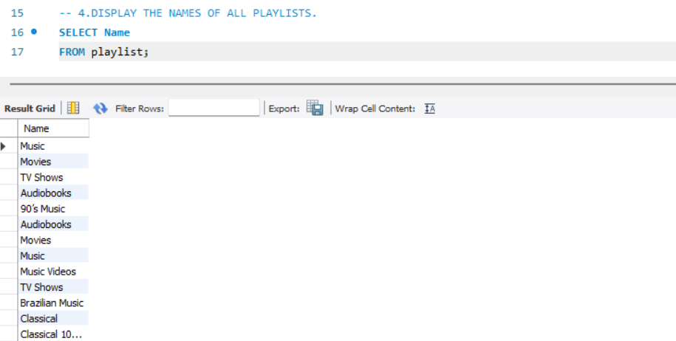
SINGLE COLUMN RETRIEVAL
This query pull just the NAME from the PLAYLIST table, helping you list all playlist title without any extra details.

Slide 6
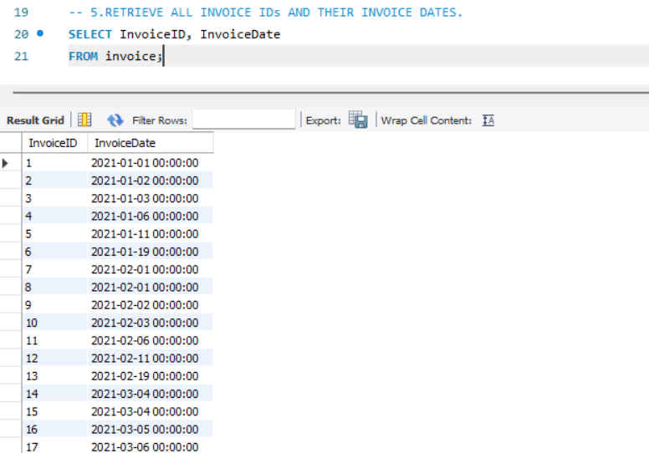
RETRIEVING SPECIFIC COLUMNS FROM A TABLE
This query pulls the INVOICEID and INVOICEDATE from the INVOICE table to display each invoice’s unique identifier alongside its issue date

Slide 7
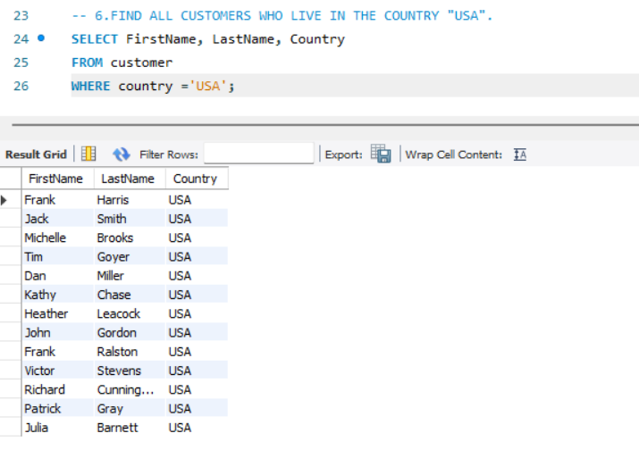
FILTERING ROWS WITH A WHERE CLAUSE
This query retrieves the first and last names of customers from the USA by applying a condition to limit results based on the COUNTRY column

Slide 8
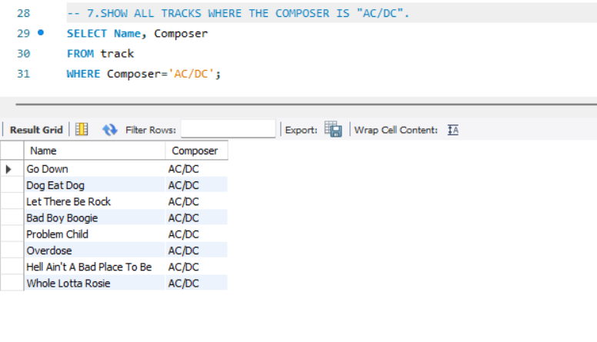
CONDITIONAL DATA RETRIEVAL WITH WHERE CLAUSE
This query fetches track names and their composer details from the TRACK table, specifically filtering for songs composed by AC/DC

Slide 9
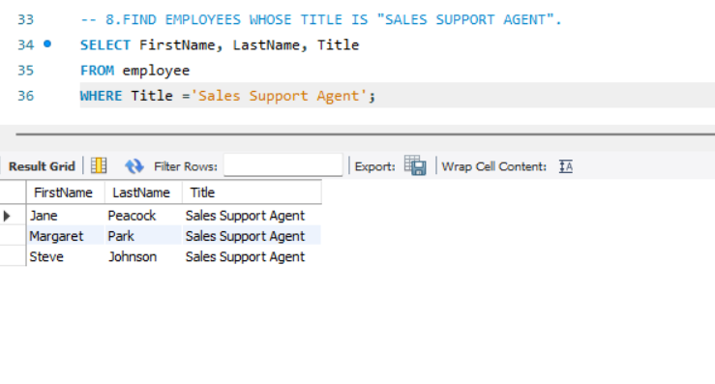
ROLE-BASED FILTERING IN SQL
This query extract employee names and job title from the EMPLOYEE table, specifically selecting those whose title is “Sales Support Agent”.

Slide 10
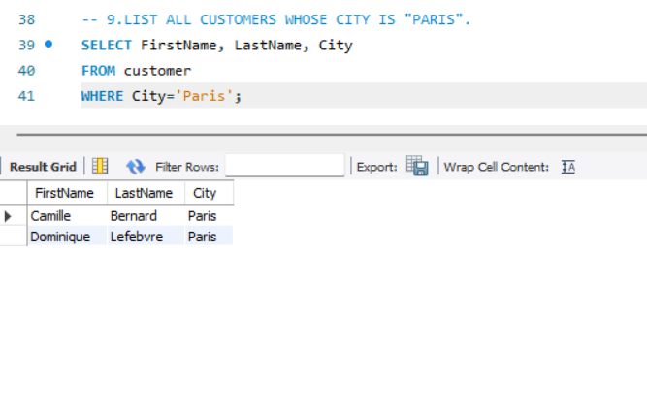
LOCATION-BASED FILTERING IN SQL
This query retrieves customer names and their city from the CUSTOMER table, specifically selecting only those who reside in paris.

Slide 11
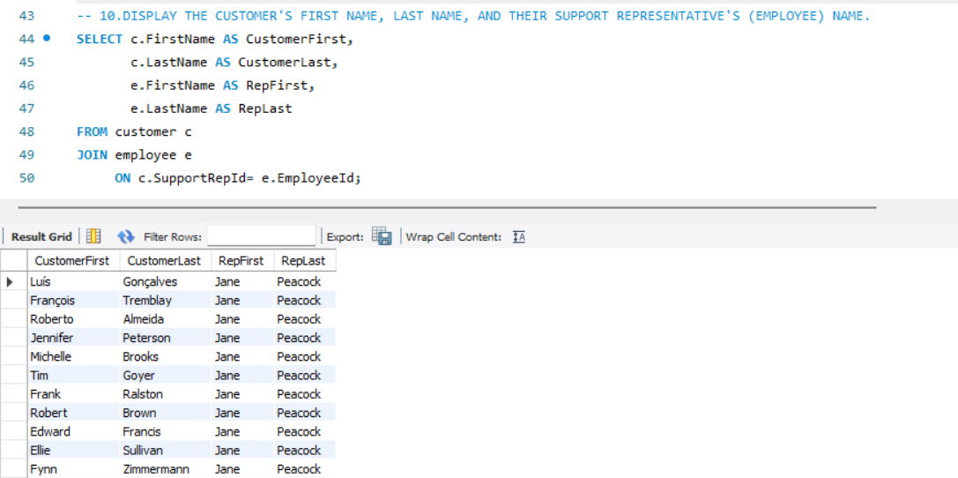
JOINING TABLES TO COMBINE RELATED DATE
This query links the CUSTOMER and EMPLOYEE tables using a JOIN to show each customer’s name along side their assigned support representative.

Slide 12
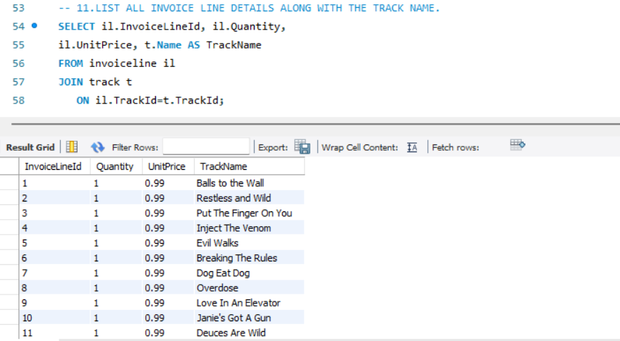
SQL JOIN CLAUSE
This query uses an INNER JOIN to combine invoice line details with track names by matching TRACKID across both tables

Slide 13
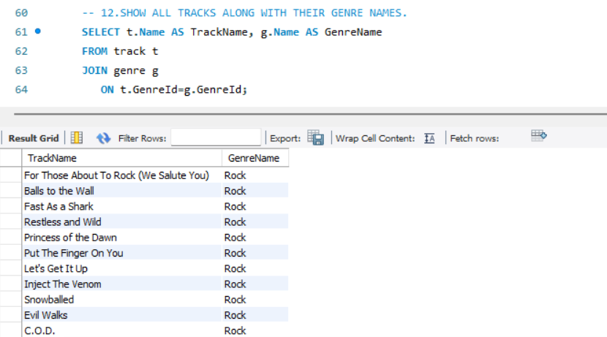
TABLE RELATIONSHIPS IN SQL
This query links tracks to their genres using a JOIN on GENRELD, showing how related table share meaningful data.

Slide 14
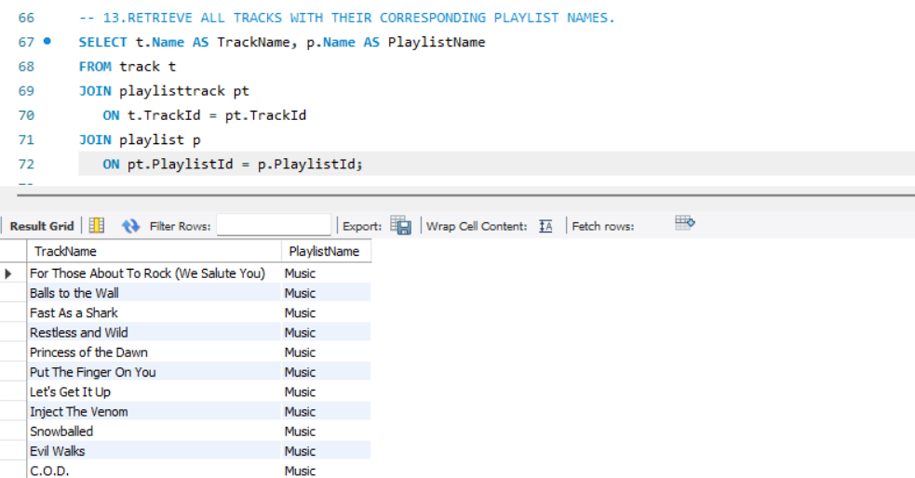
MULTI-TABLE JOINS IN SQL
This query connects track to playlists through a linking table, showing how many-to-many relationships are handled using multiple JOINs.

Slide 15
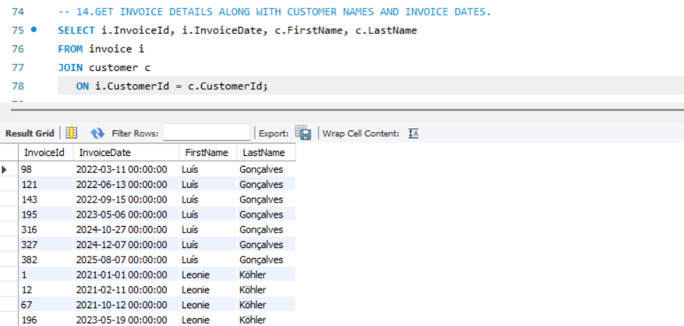
JOINING TABLES TO RETRIEVE CUSTOMER TRANSACTIONS
This query links invoices to customers using CUSTOMERID, helping track who made each purchase and when.

Slide 16
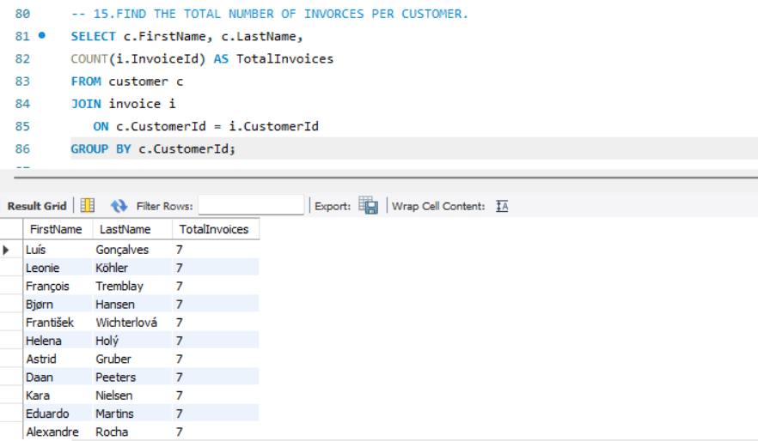
AGGREGATION WITH GROUP BY IN SQL
This query counts how many invoices each customer has by grouping records based on CUSTOMERID

Slide 17
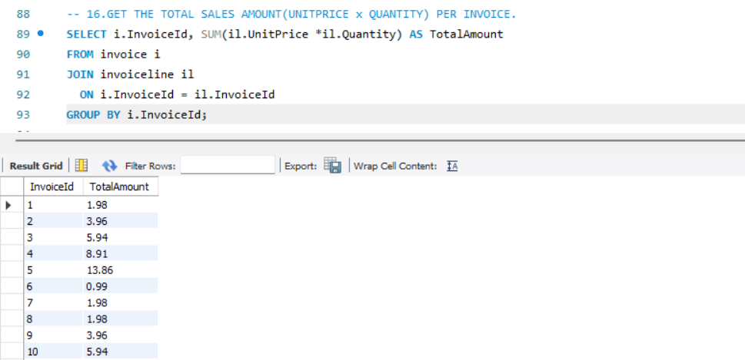
CALCULATING TOTALS WITH AGGREGATION IN SQL
This query computes the total amount for each invoice by summing the product of unit price and quantity, grouped by INVOICEID

Slide 18
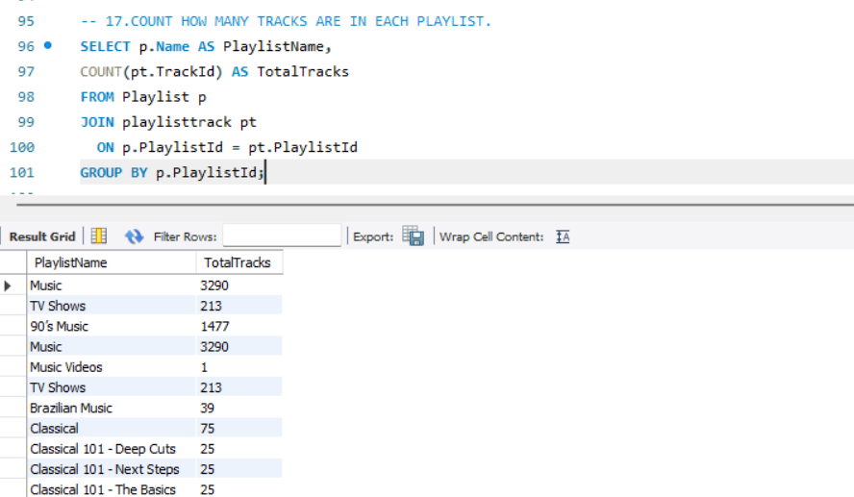
COUNTING ITEMS WITH GROUP BY IN SQL
This query counts how many tracks are in each playlist by grouping track data based on PLAYLISTID

Slide 19
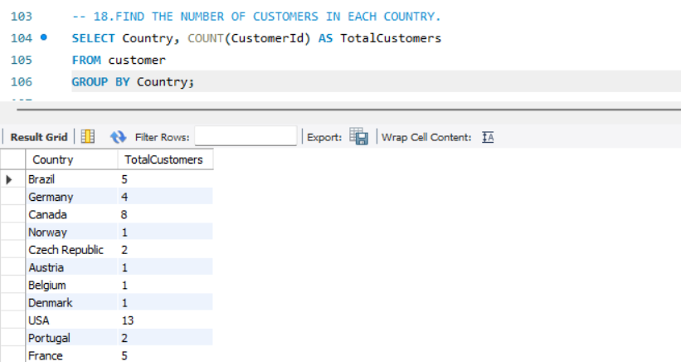
GROUPING DATA BY CATEGORY IN SQL
This query counts how many customers belong to each country by grouping records based on the COUNTRY field

Slide 20
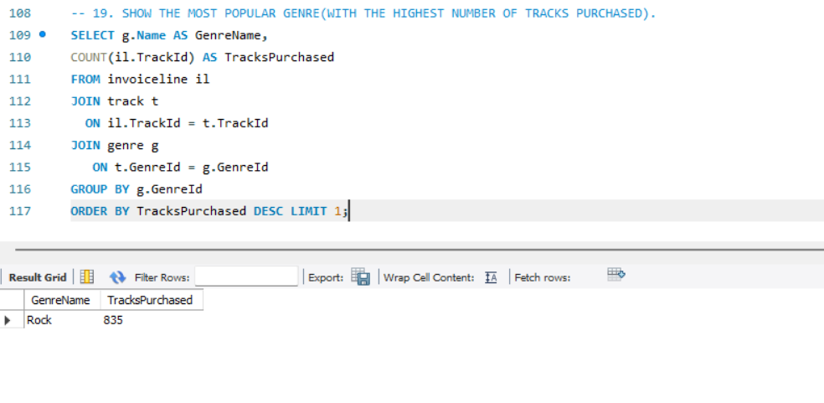
FINDING THE MOST POPULAR GENRE BY SALES IN SQL
This query identifies the genre with the highest number of purchased tracks by joining related tables and counting sales per genre

Slide 21
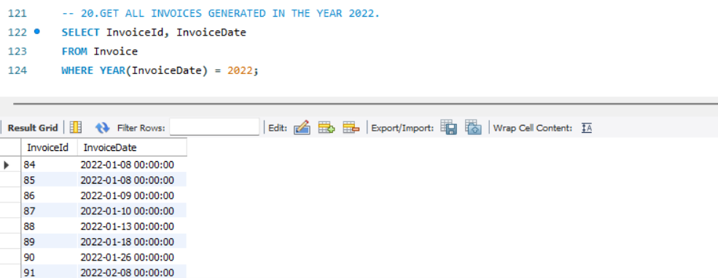
FILTERING BY YEAR IN SQL
This query retrieves invoices from the year 2022 by extracting and matching the year part of the INVOICEDATE.

Slide 22

THANKYOU
BY
PAVITHRA R

